Slide 1
SPATIAL AND TEMPORAL DATABASES

Slide 2
Time In Databases
While most databases tend to model reality at a point in time (at the ``current'' time), temporal databases model the states of the real world across time.
Facts in temporal relations have associated times when they are valid, which can be represented as a union of intervals.
The transaction time for a fact is the time interval during which the fact is current within the database system.
In a temporal relation, each tuple has an associated time when it is true; the time may be either valid time or transaction time.
A bi-temporal relation stores both valid and transaction time.

Slide 3
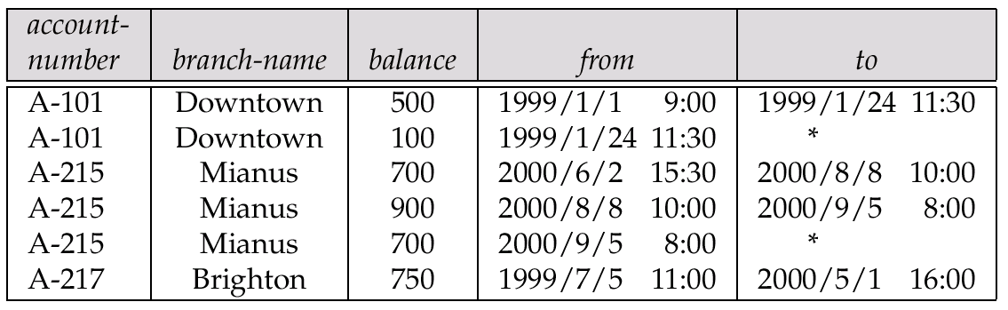
Time In Databases (Cont.)
Example of a temporal relation:
Temporal query languages have been proposed to simplify modeling of time as well as time related queries.

Slide 4
Time Specification in SQL-92
date: four digits for the year (1--9999), two digits for the month (1--12), and two digits for the date (1--31).
time: two digits for the hour, two digits for the minute, and two digits for the second, plus optional fractional digits.
timestamp: the fields of date and time, with six fractional digits for the seconds field.
Times are specified in the Universal Coordinated Time, abbreviated UTC (from the French); supports time with time zone.
interval: refers to a period of time (e.g., 2 days and 5 hours), without specifying a particular time when this period starts; could more accurately be termed a span.

Slide 5
Temporal Query Languages
Predicates precedes, overlaps, and contains on time intervals.
Intersect can be applied on two intervals, to give a single (possibly empty) interval; the union of two intervals may or may not be a single interval.
A snapshot of a temporal relation at time t consists of the tuples that are valid at time t, with the time-interval attributes projected out.
Temporal selection: involves time attributes
Temporal projection: the tuples in the projection inherit their time-intervals from the tuples in the original relation.
Temporal join: the time-interval of a tuple in the result is the intersection of the time-intervals of the tuples from which it is derived. It intersection is empty, tuple is discarded from join.

Slide 6
Temporal Query Languages (Cont.)
Functional dependencies must be used with care: adding a time field may invalidate functional dependency
A temporal functional dependency x → Y holds on a relation schema R if, for all legal instances r of R, all snapshots of r satisfy the functional dependency X →Y.
SQL:1999 Part 7 (SQL/Temporal) is a proposed extension to SQL:1999 to improve support of temporal data.
τ

Slide 7
Spatial and Geographic Databases

Slide 8
Spatial and Geographic Databases
Spatial databases store information related to spatial locations, and support efficient storage, indexing and querying of spatial data.
Special purpose index structures are important for accessing spatial data, and for processing spatial join queries.
Computer Aided Design (CAD) databases store design information about how objects are constructed E.g.: designs of buildings, aircraft, layouts of integrated-circuits
Geographic databases store geographic information (e.g., maps): often called geographic information systems or GIS.

Slide 9
Represented of Geometric Information
Various geometric constructs can be represented in a database in a normalized fashion.
Represent a line segment by the coordinates of its endpoints.
Approximate a curve by partitioning it into a sequence of segments
  Create a list of vertices in order, or
  Represent each segment as a separate tuple that also carries with it the identifier of the curve (2D features such as roads).
Closed polygons
  List of vertices in order, starting vertex is the same as the ending vertex, or
  Represent boundary edges as separate tuples, with each containing identifier of the polygon, or
  Use triangulation — divide polygon into triangles
    Note the polygon identifier with each of its triangles.

Slide 10
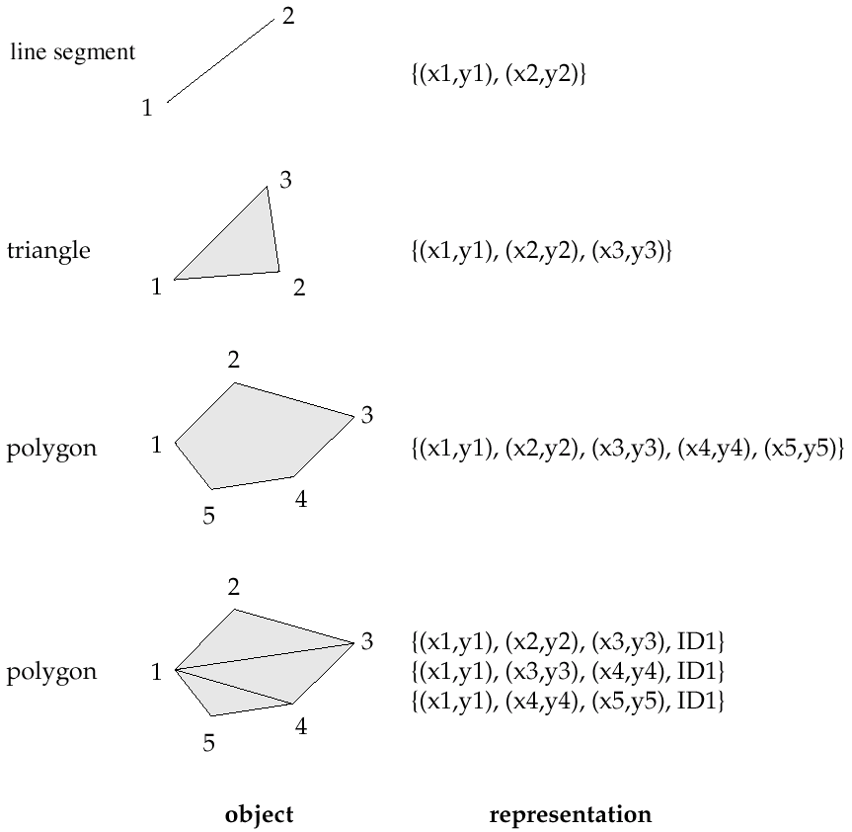
Representation of Geometric Constructs

Slide 11
Representation of Geometric Information (Cont.)
Representation of points and line segment in 3-D similar to 2-D, except that points have an extra z component
Represent arbitrary polyhedra by dividing them into tetrahedrons, like triangulating polygons.
Alternative: List their faces, each of which is a polygon, along with an indication of which side of the face is inside the polyhedron.

Slide 12
Design Databases
Represent design components as objects (generally geometric objects); the connections between the objects indicate how the design is structured.
Simple two-dimensional objects: points, lines, triangles, rectangles, polygons.
Complex two-dimensional objects: formed from simple objects via union, intersection, and difference operations.
Complex three-dimensional objects: formed from simpler objects such as spheres, cylinders, and cuboids, by union, intersection, and difference operations.
Wireframe models represent three-dimensional surfaces as a set of simpler objects.

Slide 13
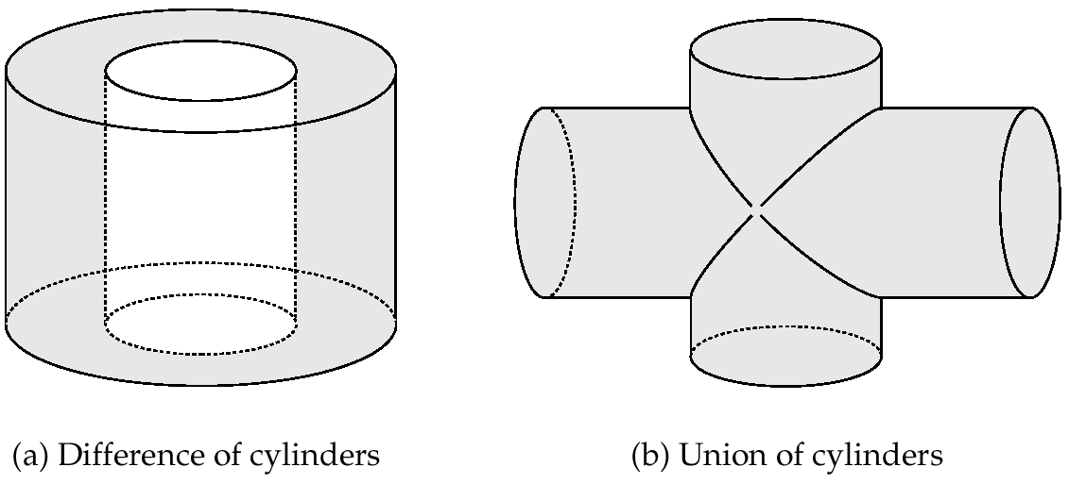
Representation of Geometric Constructs
(a) Difference of cylinders
(b) Union of cylinders
Design databases also store non-spatial information about objects (e.g., construction material, color, etc.)
Spatial integrity constraints are important.
  E.g., pipes should not intersect, wires should not be too close to each other, etc.

Slide 14
Geographic Data
Raster data consist of bit maps or pixel maps, in two or more dimensions.
  Example 2-D raster image: satellite image of cloud cover, where each pixel stores the cloud visibility in a particular area.
  Additional dimensions might include the temperature at different altitudes at different regions, or measurements taken at different points in time.
Design databases generally do not store raster data.

Slide 15
Geographic Data (Cont.)
Vector data are constructed from basic geometric objects: points, line segments, triangles, and other polygons in two dimensions, and cylinders, speheres, cuboids, and other polyhedrons in three dimensions.
Vector format often used to represent map data.
  Roads can be considered as two-dimensional and represented by lines and curves.
  Some features, such as rivers, may be represented either as complex curves or as complex polygons, depending on whether their width is relevant.
  Features such as regions and lakes can be depicted as polygons.

Slide 16
Applications of Geographic Data
Examples of geographic data
  map data for vehicle navigation
  distribution network information for power, telephones, water supply, and sewage
Vehicle navigation systems store information about roads and services for the use of drivers:
  Spatial data: e.g, road/restaurant/gas-station coordinates
  Non-spatial data: e.g., one-way streets, speed limits, traffic congestion
Global Positioning System (GPS) unit - utilizes information broadcast from GPS satellites to find the current location of user with an accuracy of tens of meters.
  increasingly used in vehicle navigation systems as well as utility maintenance applications.

Slide 17
Spatial Queries
Nearness queries request objects that lie near a specified location.
Nearest neighbor queries, given a point or an object, find the nearest object that satisfies given conditions.
Region queries deal with spatial regions. e.g., ask for objects that lie partially or fully inside a specified region.
Queries that compute intersections or unions of regions.
Spatial join of two spatial relations with the location playing the role of join attribute.

Slide 18
Spatial Queries (Cont.)
Spatial data is typically queried using a graphical query language; results are also displayed in a graphical manner.
Graphical interface constitutes the front-end
Extensions of SQL with abstract data types, such as lines, polygons and bit maps, have been proposed to interface with back-end.
  allows relational databases to store and retrieve spatial information
  Queries can use spatial conditions (e.g. contains or overlaps).
  queries can mix spatial and nonspatial conditions

Slide 19
Indexing of Spatial Data
k-d tree - early structure used for indexing in multiple dimensions.
Each level of a k-d tree partitions the space into two.
  choose one dimension for partitioning at the root level of the tree.
  choose another dimensions for partitioning in nodes at the next level and so on, cycling through the dimensions.
In each node, approximately half of the points stored in the sub-tree fall on one side and half on the other.
Partitioning stops when a node has less than a given maximum number of points.
The k-d-B tree extends the k-d tree to allow multiple child nodes for each internal node; well-suited for secondary storage.

Slide 20
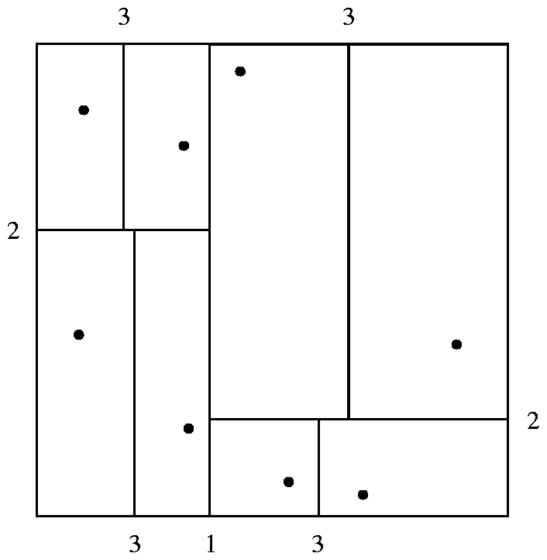
Division of Space by a k-d Tree
Each line in the figure (other than the outside box) corresponds to a node in the k-d tree
  the maximum number of points in a leaf node has been set to 1.
The numbering of the lines in the figure indicates the level of the tree at which the corresponding node appears.

Slide 21
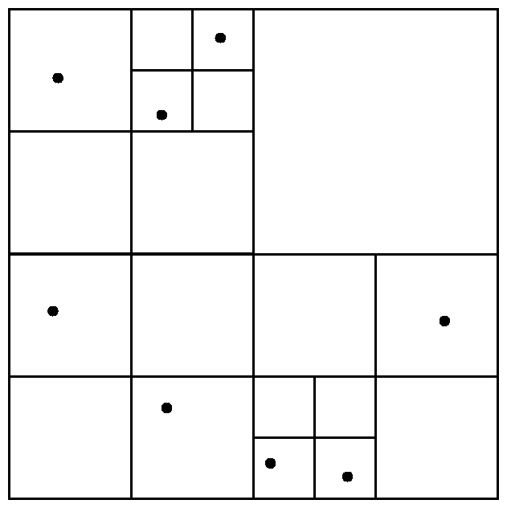
Division of Space by Quadtrees
Quadtrees
Each node of a quadtree is associated with a rectangular region of space; the top node is associated with the entire target space.
Each non-leaf nodes divides its region into four equal sized quadrants
  correspondingly each such node has four child nodes corresponding to the four quadrants and so on
Leaf nodes have between zero and some fixed maximum number of points (set to 1 in example).

Slide 22
Quadtrees (Cont.)
PR quadtree: stores points; space is divided based on regions, rather than on the actual set of points stored.
Region quadtrees store array (raster) information.
  A node is a leaf node is all the array values in the region that it covers are the same. Otherwise, it is subdivided further into four children of equal area, and is therefore an internal node.
  Each node corresponds to a sub-array of values.
  The sub-arrays corresponding to leaves either contain just a single array element, or have multiple array elements, all of which have the same value.
Extensions of k-d trees and PR quadtrees have been proposed to index line segments and polygons
  Require splitting segments/polygons into pieces at partitioning boundaries
    Same segment/polygon may be represented at several leaf nodes

Slide 23
R-Trees
R-trees are a N-dimensional extension of B⁺-trees, useful for indexing sets of rectangles and other polygons.
Supported in many modern database systems, along with variants like R⁺ -trees and R*-trees.
Basic idea: generalize the notion of a one-dimensional interval associated with each B+ -tree node to an
N-dimensional interval, that is, an N-dimensional rectangle.
Will consider only the two-dimensional case (N = 2)
  generalization for N > 2 is straightforward, although R-trees work well only for relatively small N

Slide 24
R Trees (Cont.)
A rectangular bounding box is associated with each tree node.
  Bounding box of a leaf node is a minimum sized rectangle that contains all the rectangles/polygons associated with the leaf node.
  The bounding box associated with a non-leaf node contains the bounding box associated with all its children.
  Bounding box of a node serves as its key in its parent node (if any)
  Bounding boxes of children of a node are allowed to overlap
A polygon is stored only in one node, and the bounding box of the node must contain the polygon
  The storage efficiency or R-trees is better than that of k-d trees or quadtrees since a polygon is stored only once

Slide 25
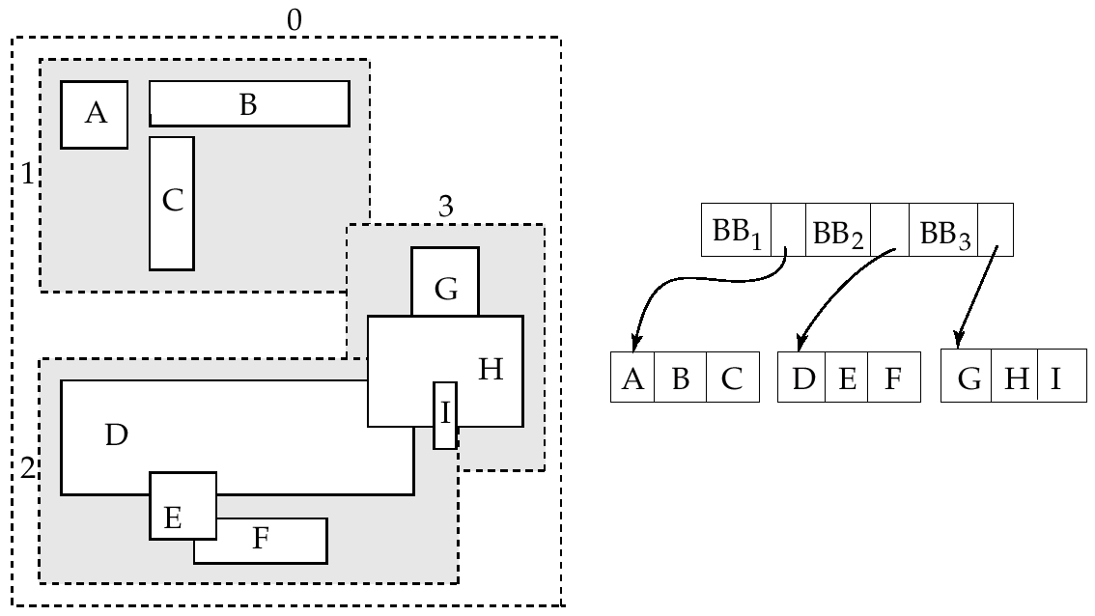
Example R-Tree
A set of rectangles (solid line) and the bounding boxes (dashed line) of the nodes of an R-tree for the rectangles. The R-tree is shown on the right.

Slide 26
Search in R-Trees
To find data items (rectangles/polygons) intersecting (overlaps) a given query point/region, do the following, starting from the root node:
  If the node is a leaf node, output the data items whose keys intersect the given query point/region.
  Else, for each child of the current node whose bounding box overlaps the query point/region, recursively search the child
Can be very inefficient in worst case since multiple paths may need to be searched
  but works acceptably in practice.
Simple extensions of search procedure to handle predicates contained-in and contains

Slide 27
Insertion in R-Trees
To insert a data item:
  Find a leaf to store it, and add it to the leaf
    To find leaf, follow a child (if any) whose bounding box contains bounding box of data item, else child whose overlap with data item bounding box is maximum
  Handle overflows by splits (as in B+ -trees)
    Split procedure is different though (see below)
  Adjust bounding boxes starting from the leaf upwards
Split procedure:
  Goal: divide entries of an overfull node into two sets such that the bounding boxes have minimum total area
    This is a heuristic. Alternatives like minimum overlap are possible
  Finding the “best” split is expensive, use heuristics instead
    See next slide

Slide 28
Splitting an R-Tree Node
Quadratic split divides the entries in a node into two new nodes as follows
  Find pair of entries with “maximum separation”
    that is, the pair such that the bounding box of the two would has the maximum wasted space (area of bounding box – sum of areas of two entries)
  Place these entries in two new nodes
  Repeatedly find the entry with “maximum preference” for one of the two new nodes, and assign the entry to that node
    Preference of an entry to a node is the increase in area of bounding box if the entry is added to the other node
  Stop when half the entries have been added to one node
    Then assign remaining entries to the other node
Cheaper linear split heuristic works in time linear in number of entries,
  Cheaper but generates slightly worse splits.

Slide 29
Deleting in R-Trees
Deletion of an entry in an R-tree done much like a B⁺-tree deletion.
  In case of underfull node, borrow entries from a sibling if possible, else merging sibling nodes
  Alternative approach removes all entries from the underfull node, deletes the node, then reinserts all entries

